Slide 1

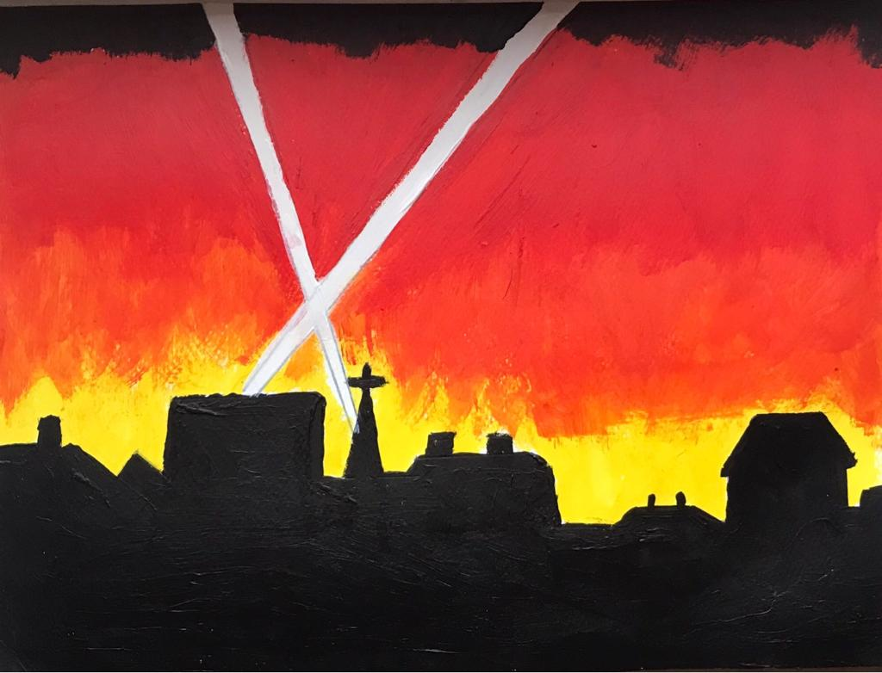
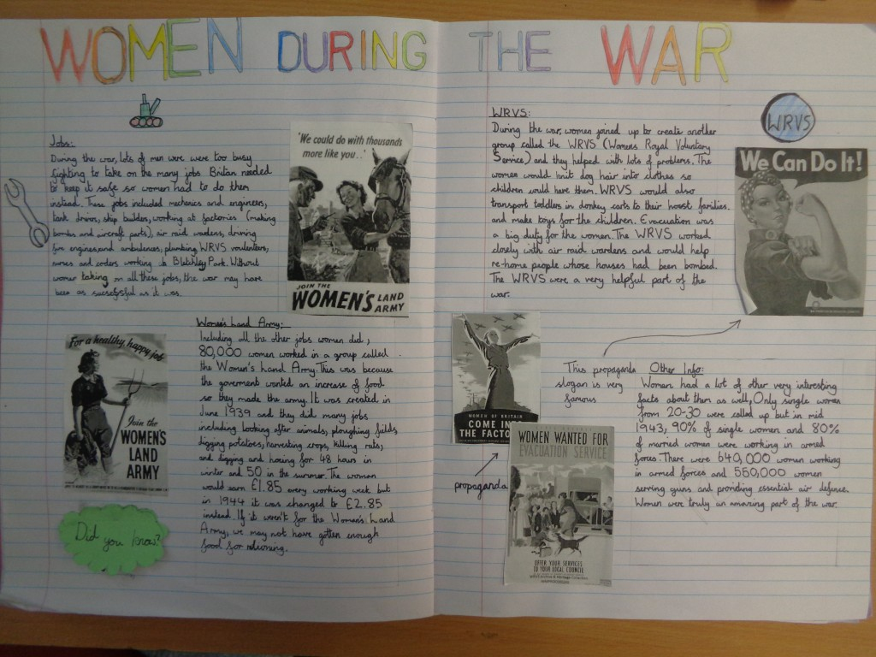
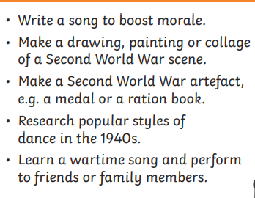
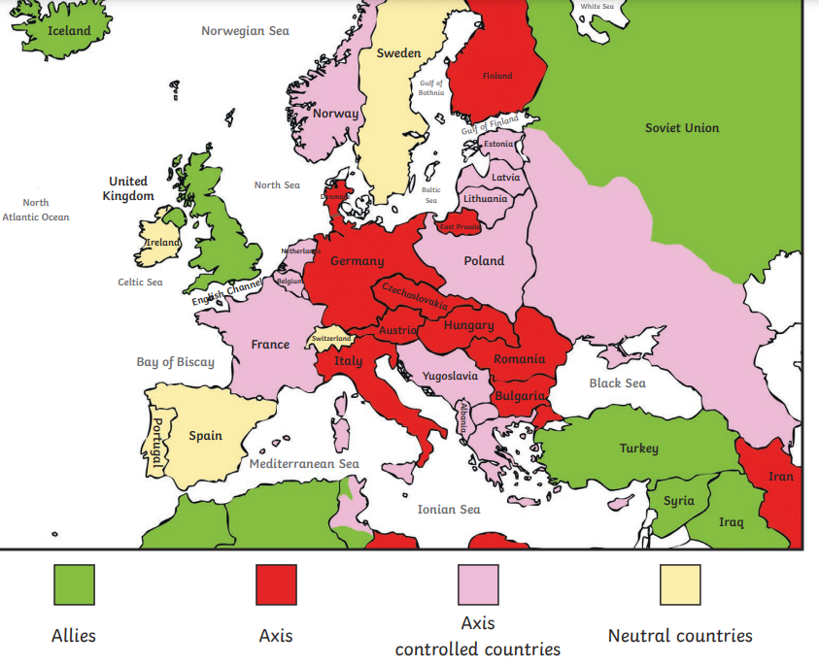
Autumn Wider curriculum Homework
Welcome to year 6 .I have created some homework ideas, designed to engage the children further in their wider curriculum learning. I would also like them to take you on this journey with them. However, please do not fear or stress over the homework. I will do my best to provide extra resources if needed but these activities are designed for fun. Each child must complete at least 3 of the homework’s this half term. The sooner they are done, the nicer the class display will look. However there is no formal deadline. If your child would like to do more than three the sky is the limit. I am looking for high quality year 6 pieces of work that we would be proud to display.
SCIENCE: Make a safety poster with details around how we stay safe around electricity. You should include information on conductors and insulators. The BBC Bitesize link has some great information and videos you could use to help you. You could even design a poster on Google Classroom if you wish. https://www.bbc.co.uk/bitesize/topics/zj44jxs | HISTORY: WWII research the Battle of Britain and present your findings however you like: Fact file Poster Powerpoint presentation Video Newspaper report The list is endless. Consider why this battle is a significant part of British history.
ART: Create your own pieces of art work to represent the Blitz. | WRITING: Create double page spreads on WWII. You could chose the part you want to research or give me an overview of one aspect. It should be an information text.
OTHER IDEAS: Choose from: | GEOGRAPHY: Draw or trace a map of the world and mark countries which were allied forces or Axis forces- use a key.

