Slide 1








  How do we teach Maths at St Anne’s?
Parents workshop
Monday 18th November 2024

Slide 2








  First of all…. A disclaimer!
In today’s workshop, we will:
Discuss the 3 main areas of the National Curriculum for Maths
Talk about the mastery approach
Talk about a typical Maths lesson
Show you our St Anne’s Maths curriculum
Share some resources that we use in school
Share some resources that you can use at home
Share some useful websites
Share some useful games/activities that you can try out at home
A
B
C

Slide 3
  Why do we learn Maths?
Always draw out real life links to Maths around your home
Talk about how you use Maths in your job!
Point out that their dream job involves Maths!
Be positive about Maths!
A
B
C

Slide 4
  The Maths National Curriculum
There are 3 main strands:
Fluency
Reasoning
Problem Solving
Our lessons aim to involve all 3 skills every single lesson.
Maths is so much more than providing the correct answer!
A
B
C

Slide 5

  Our Curriculum
We follow a Mastery Approach and use ‘White Rose’ to help us sequence and plan our lessons.
A
B
C

Slide 6
  Our Mastery Approach
Everyone can succeed at Maths!
We break down concepts into ‘small steps.’
We explain Maths concepts using visuals and equipment.
We provide the children with ‘stem sentences.’
We ask them to repeat phrases ‘I say, you say’
We constantly assess the children in every lesson and fill any gaps through ‘hot spots’ and/or ‘pre-teach’ opportunities.
A
B
C

Slide 7

  How do children “Master” number?
Children have short 10 minute activities as part of ‘Fluency Bee’ tagged onto the start of their Maths lessons to develop their fluency skills.
A
B
C

Slide 8
How is my child stretched if they already know how to count all of the numbers up to 10 or 20?
We ‘delve deeper’ into topics rather than going on to the next year group’s learning.
A
B
C

Slide 9
How is my child challenged?
Expanding on already taught material
Retaining information
Articulating learning
How did you get to that answer?
What’s the same, what’s different?
A
B
C

Slide 10
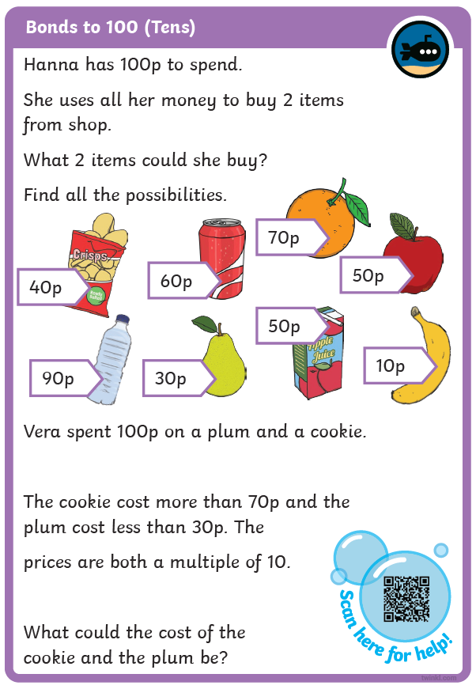
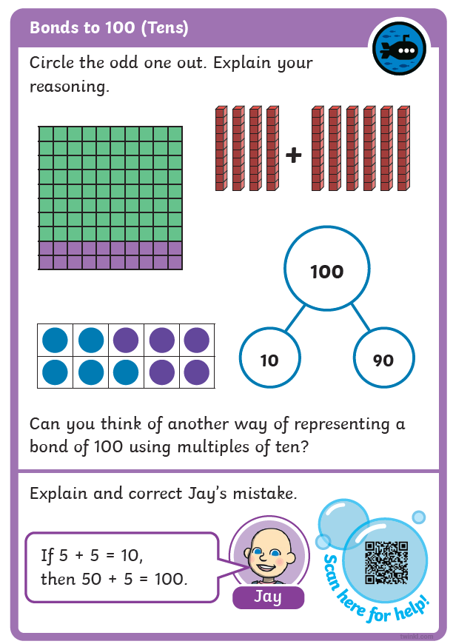
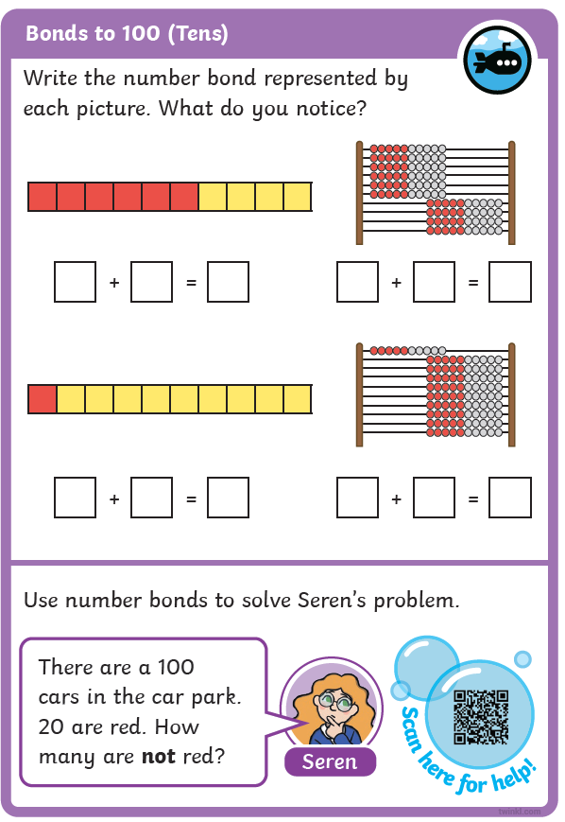
How is my child challenged?
Diving into Mastery
A
B
C

Slide 11
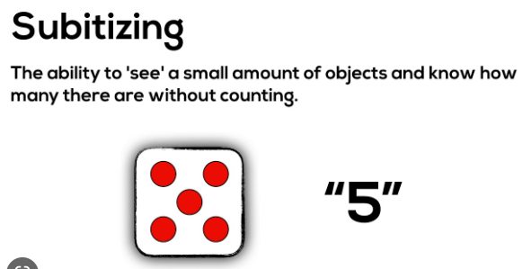

Some new terminology!
What do you see?
A
B
C

Slide 12
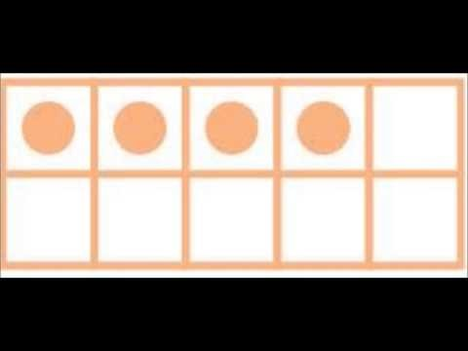
Say what you see!
A
B
C

Slide 13
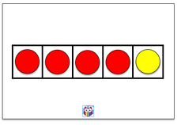


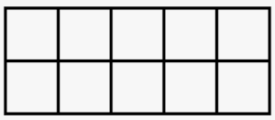
Visuals
Fives frames
Tens frames
A
B
C

Slide 14
Across the school, we use manipulatives to model, encourage jottings and then move onto the abstract after this.
Concrete
Pictorial
Abstract
A
B
C

Slide 15
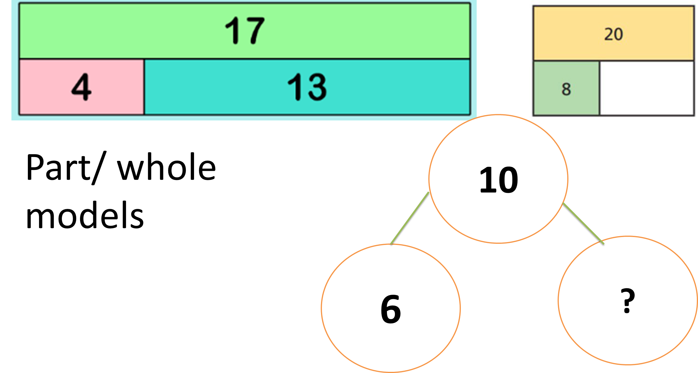
Bar Models
A
B
C

Slide 16
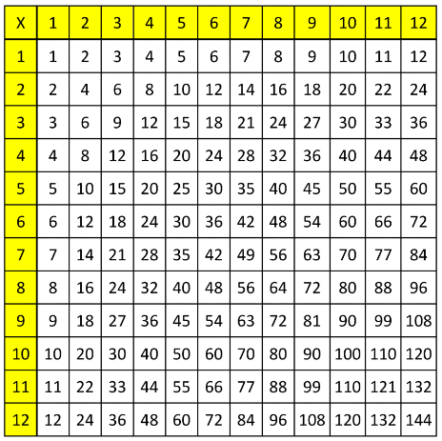
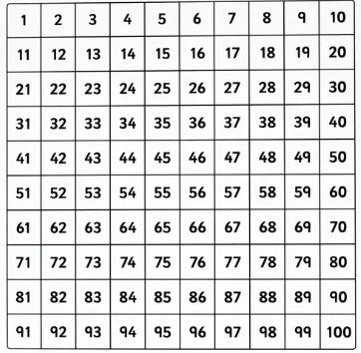

Times table grids
100 squares
Number lines
A
B
C

Slide 17
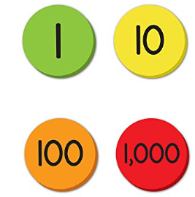
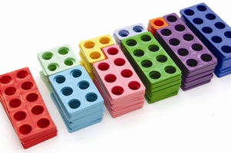
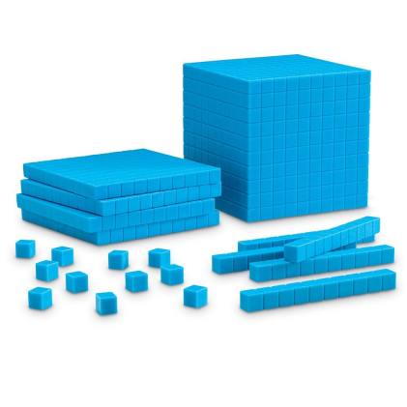
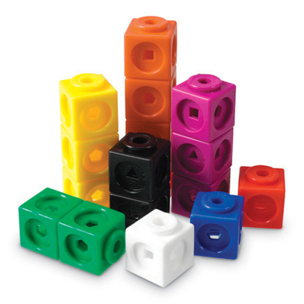
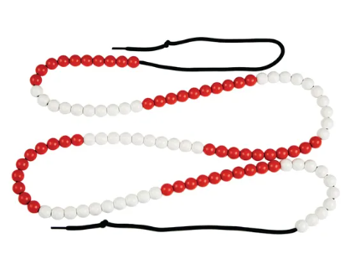
Counters
Manipulatives
Numicon
Deines/Base 10
Multi-link cubes
A
B
C
Bead String

Slide 18
Your Turn
Use the Numicon on your table to find number bonds to 10
A
B
C

Slide 19
How can you support at home
Practise spotting and recognising numbers in the environment. Add/multiply/subtract/divide door numbers, numbers on car registration plates, road signs and at the shop.
Ask your child to calculate the length of their favourite programmes. How long is it until the next programme?
A
B
C

Slide 20



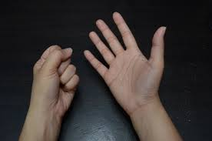
Resources you could use at home
Lego can be used as multilink.
Group everyday items into sets to understand division, remainders, multiplication etc.
Eg 14 divided by 2= 5r4
Encourage your child to draw the problem.
1/3 of 9 =
Also, encourage them to use their fingers!
A
B
C

Slide 21
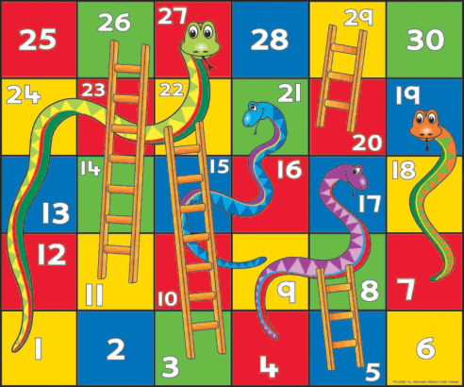


Other everyday resources that can help your child’s Maths skills at home
Board Games supply endless opportunities for Maths – Snakes and Ladders, Monopoly, Bingo, Connect Four, Battle Ships etc
Practise telling the time with your child. Can they read both the digital and analogue clock?
Can they also recognise Roman Numeral representations of the time too?
A
B
C

Slide 22
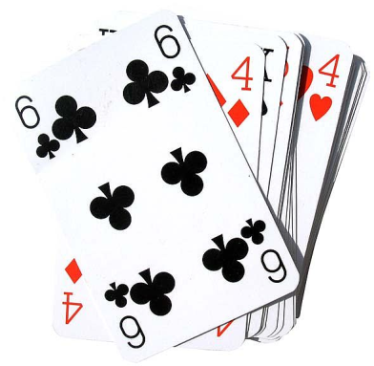
A quick game of 21
A
B
C

Slide 23
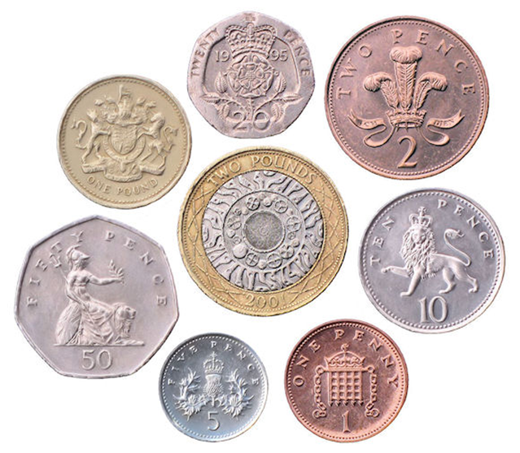
Using Money
Allow your children to use real coins.
Can they work out which coins they will need to buy something?
Can they use the smallest number of coins?
Can they calculate their change?
A
B
C

Slide 24
SATS
SATS
Tests are given to Year 2 and Year 6 students in May/June.
Children are given arithmetic and reasoning papers.
In the test, children will not be allowed to use any counting resources. However they need to use them in class first of all to support their understanding.
A
B
C

Slide 25
SATS
Understanding multiplication and recalling times table facts are key!
Division
Fractions
Ratio
Proportion
Percentages
Decimals
Algebra
Converting measures
All of these topics (and more) stem from multiplication!!!
A
B
C

Slide 26
SATS
Y4 MTC
Year 4 will sit a statutory test in June.
There will be 25 mixed questions up to 12 x 12
They will only have 6 seconds per question!
They will use an ipad to type in their answers
‘Practise makes perfect’
A
B
C

Slide 27
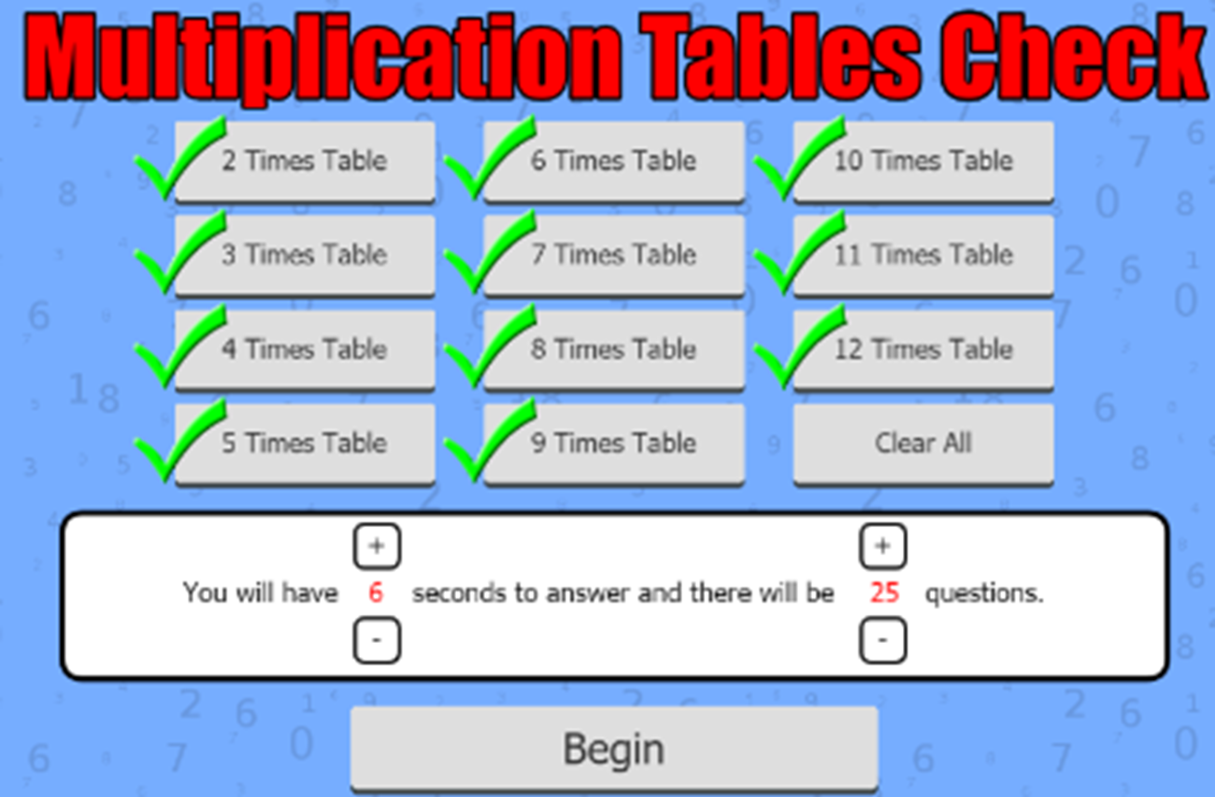
SATS
Y4 MTC
Times Table Rockstars
Hit the button
Topmarks
Mathsframe Multiplication Tables Check (click adjust difficulty)
A
B
C

Slide 28
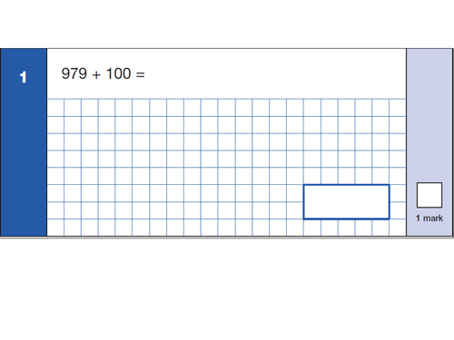
SATS
Arithmetic Questions
Children are encouraged to show their working out.
They can draw diagrams if they wish to help them to solve problems.
Example:
A
B
C

Slide 29
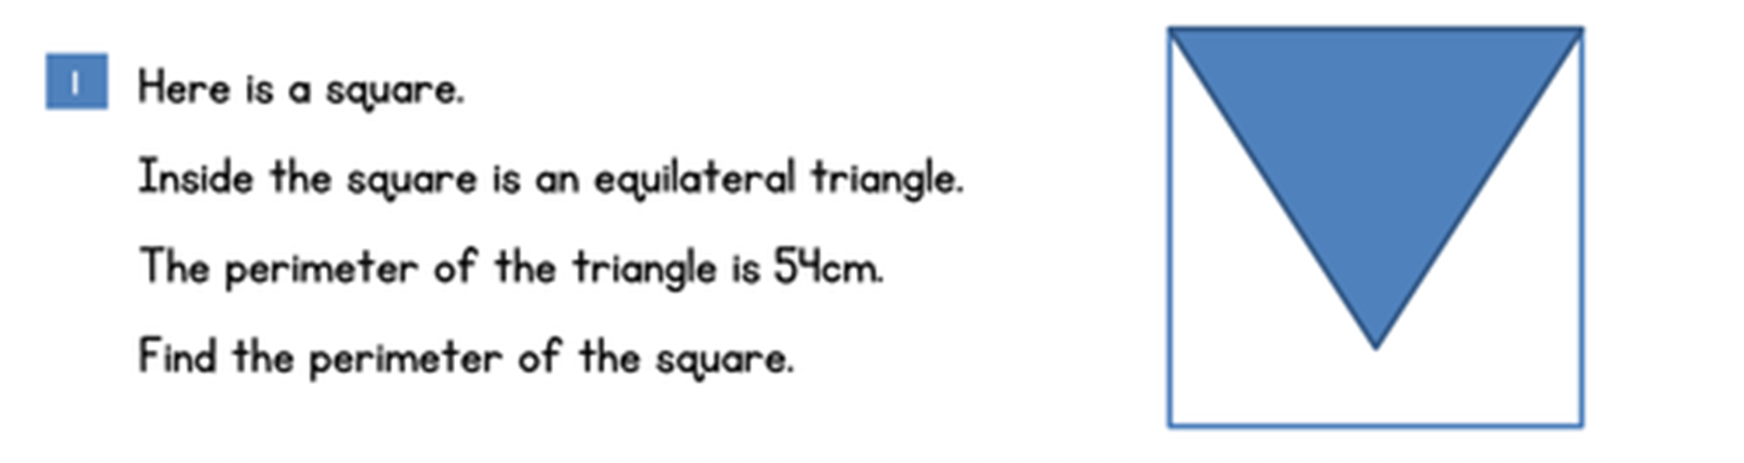
SATS
Reasoning Questions
There is a big emphasis on reasoning/problem solving in the Maths curriculum.
Children need to be able to explain their thinking. What do they know?
We encourage children to use the correct mathematical language in their answers.
Example:
A
B
C

Slide 30
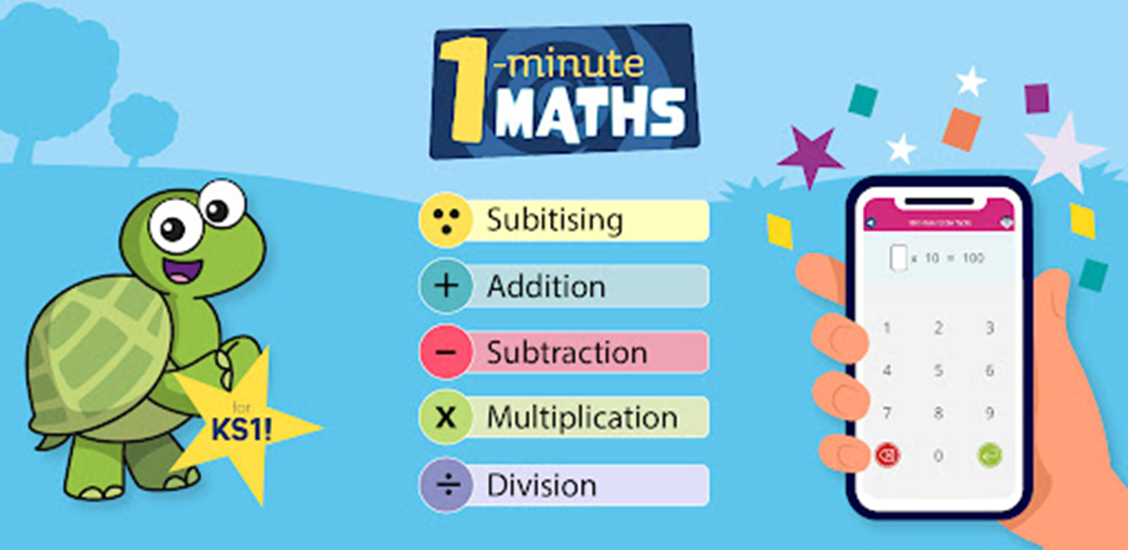
SATS
Useful Websites you can use at home
Mathletics (always use a pencil and paper to make jottings) or use real life objects to help
1 Minute Maths App
Mathsbot (online manipulatives)
Topmarks (different topics)
Nrich (challenging tasks)
A
B
C

