Slide 1

Accelerated Reader: A Guide for Parents
12.11.19

Slide 2


Notes:
https://ukhosted62.renlearn.co.uk/1892677/default.aspx If they can’t find it

Slide 3

Accelerated Reader: A Guide for Parents
In KS2 all children take part in the Accelerated Reader programme, which is designed to do the following things:
Find books that are the right ability for your child
Encourage your child to read more
Improve your child’s reading ability.

Slide 4
STAR Reading tests
Each term children in KS2 (and year 2 when ready) take a test on a computer or Ipad called STAR Reading.
The test uses multiple-choice timed questions to determine a child's reading level.
Questions in STAR reading adjust to a child's responses so if they respond correctly, the difficulty increases and if they answer incorrectly, the difficulty level is reduced.
When a child has completed the test their teacher can find out their 'Zone of Proximal Development (ZPD).

Slide 5

The ZPD Score
3.2 – 4.6
ZPD is two numbers that the children use to choose their next reading book.
The lowest number is the lowest level of book your child should be choosing.
The highest number is the highest level of book your child should be choosing.
Children keep a record of all their ZPDs in their reading records.
Lowest number
Highest number

Slide 6

Children must take their time. It is recommended that each child should spend at least 20 minutes on their tests. The STAR test it is about concentration, focus and careful reading.
Children should not guess answers to questions. Instead, they should wait for the question to time out. This is to ensure the computer is not given a false impression of the student’s reading ability.
Tests are done independently in a controlled environment.

Slide 7
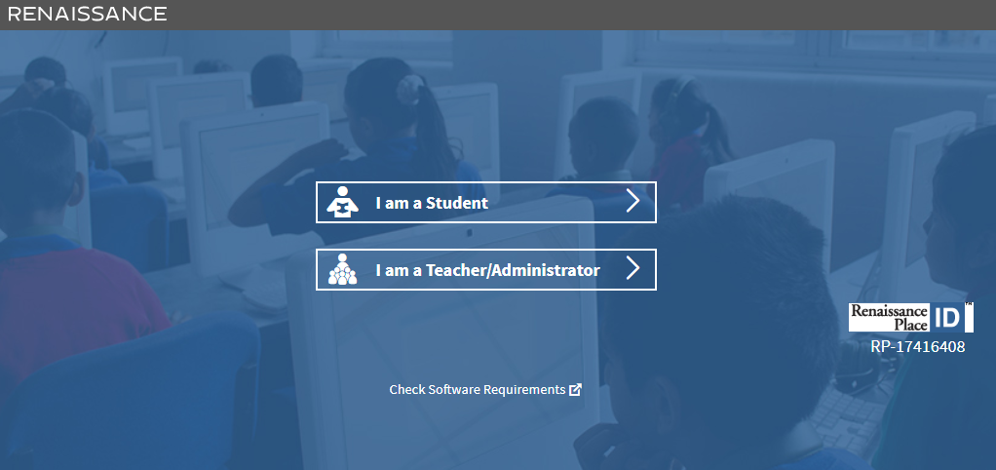

Slide 8
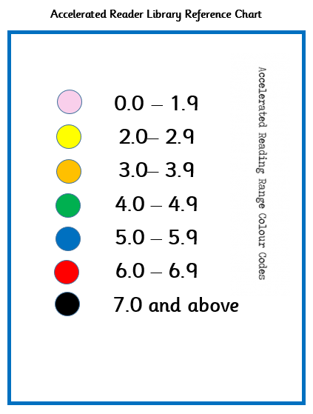

All the AR books in the Library are colour-coded to help the children find the right one.
Children should only choose books within their ZPD range and and the colours make it easier for them to choose the right book.

Slide 9
What happens when my child has read his/her book?
They take an Accelerated Reader quiz.
A quiz is different to a STAR test because children only take a quiz after they have finished a book.
There are usually about 10 questions on the book that has been read. At the end of the quiz the children are given a percentage to show them how well they have done.

Slide 10
AR Quizzes
As mentioned above, children take a quiz once they have finished their book. It is important that children take their quiz as soon as possible after finishing their book (no more that a week later!) as this can affect their scores. Once they have finished their quiz children can immediately see if they have passed. If they pass they can review their incorrect answers.

Slide 11
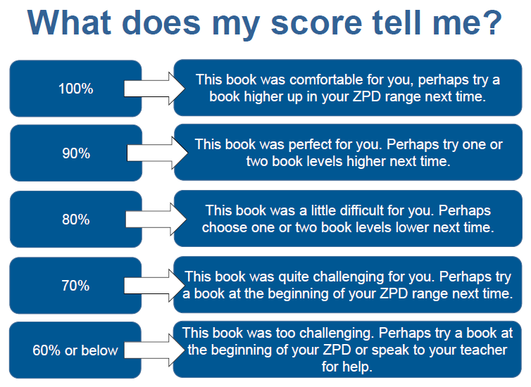
AR Quizzes

Slide 12
AR Quizzes
There are some important rules for taking quizzes:
The book the child is quizzed on must be a book they have read in the last two weeks. AR is not a memory test but rather measuring reading ability.
A child cannot take a quiz until they have read the entire text.
Quizzes must be done individually, not with anyone’s help.

Slide 13

How do our children get rewarded?
In AR quizzes:
80% - A pass and awarded 2 team points
For every 100% children are awarded 5 team points.
How is success celebrated within the Key Stage?
Display in the shared area
Updated weekly to show number of quizzes passed.

Slide 14
“How can I help?”
As with anything, performance improves with practice.
Encourage your child to read at home.
Create a culture of reading in your household by reading with your child, starting a home library, visiting your local library, charity shop or bookshop on a regular basis and by letting your child see you reading.
When reading with your child stop and ask questions to be sure your child comprehends what they have read and in general make a habit of discussing books that each of you has read.

Slide 15
“How do I know how my child is doing?”
After each STAR test, a new ZPD range is shared and a sticker is placed in your child’s Reading Record.
Any progress made will be evident as the range should widen and increase.
The result of each AR quiz is shared immediately after it has been taken via the same process.
Renaissance Home Connect https://ukhosted39.renlearn.co.uk/2246662/HomeConnect/

Slide 16
ARBookFind.co.uk
It’s not just books from St Anne’s that children can read, they can read books from home and take quizzes on them!
You can use ARBookFind.co.uk to check whether your child’s current book is on Accelerated Reader.
https://www.arbookfind.co.uk/default.aspx?client=homeconnectuk

Slide 17


