Slide 1

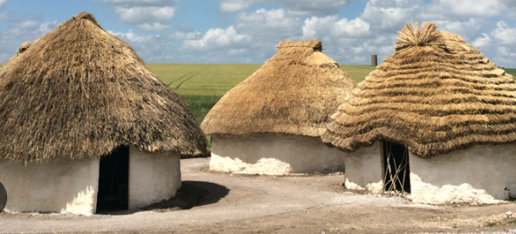
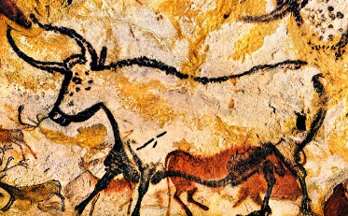
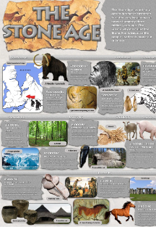
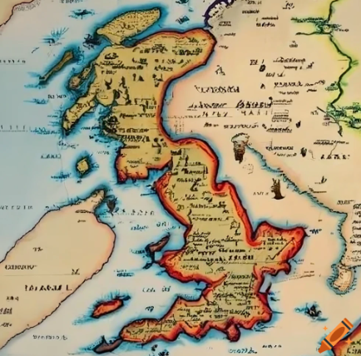
Autumn Wider curriculum Homework
Welcome to Year 3. I have created some homework ideas, designed to engage the children further in their wider curriculum learning. Each child must complete at least 3 of the homework’s this term. Please return homework by 9th October so that we have time to share your child’s work as a class. If your child would like to do more than three the sky is the limit. I am looking for amazing pieces of work that we would be proud to display to show off our knowledge and skills.
SCIENCE: Look at pictures of Stone Age animals (e.g. mammoths) – how were they adapted for their habitats? What happened to them when the climate changed? Find out about fossils. What are they? How are they formed? | HISTORY: Research key facts about the Stone Age, create a poster either paper or digital. Build some simple shelters. What makes a good shelter?
ART: Create your own pieces of art work to represent The Stone Age. | WRITING: Create . Write a leaflet – “How to survive in the Stone/Bronze/Iron Age”. You could use some information from the BBC’s Horrible Histories videos.
OTHER IDEAS: Find out about prehistoric musical instruments and musical stones Create raps about Stone Age life Make up your own lullaby for Cave Baby Make a Stone Age necklace Or think of your own ideas if you are feeling creative. | GEOGRAPHY: Research maps and find out what happened in the Stone age and label where countries/continents have moved.

