Slide 1

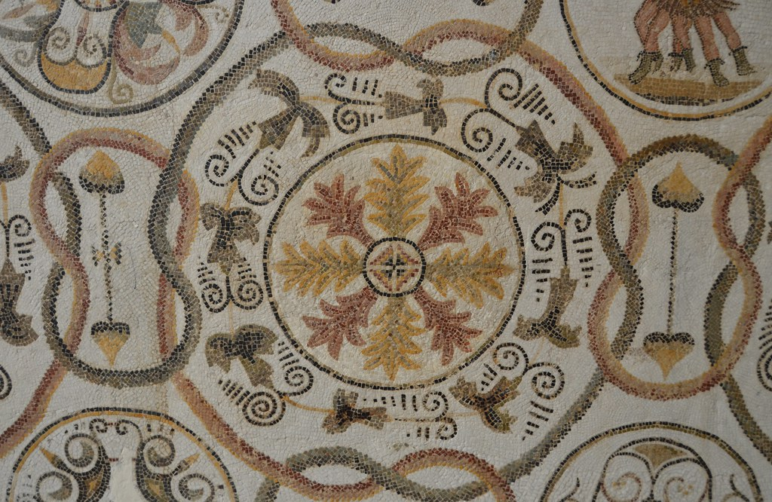
Spring 1 Wider curriculum Homework
Each child must complete at least 3 of the homework’s this half term. The sooner they are done, the nicer the class display will look. We will then share the children’s learning on Thursday 12th February. If your child would like to do more than three or something that isn’t on the sheet, they are encouraged to do so, the sky is the limit! I am looking for amazing pieces of work that we would be proud to display to show off our knowledge and skills.
SCIENCE: Go out on a rock hunt. What rocks can you find? Can you identify these rocks? Create scientific drawings of the rocks you find. | HISTORY: Research key facts about the Romans, create a poster either paper or digital. Research and build a Roman settlement, solider, shield or helmet.
ART: Create your own pieces of art work to represent Roman mosaics. | WRITING: Write a poem about the Romans. We will be learning Haiku’s in class but you could research another poetry type e.g limerick, kenning, rhyming couplet poem
OTHER IDEAS: Research and create one of the famous Roman landmarks/historical sites. Create raps about Roman life Research key Roman events Make a timeline of the Romans Or think of your own ideas if you are feeling creative. | GEOGRAPHY: Research maps and find out about the Roman empire.

