Slide 1

Title page

Slide 2

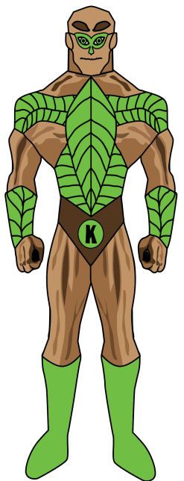
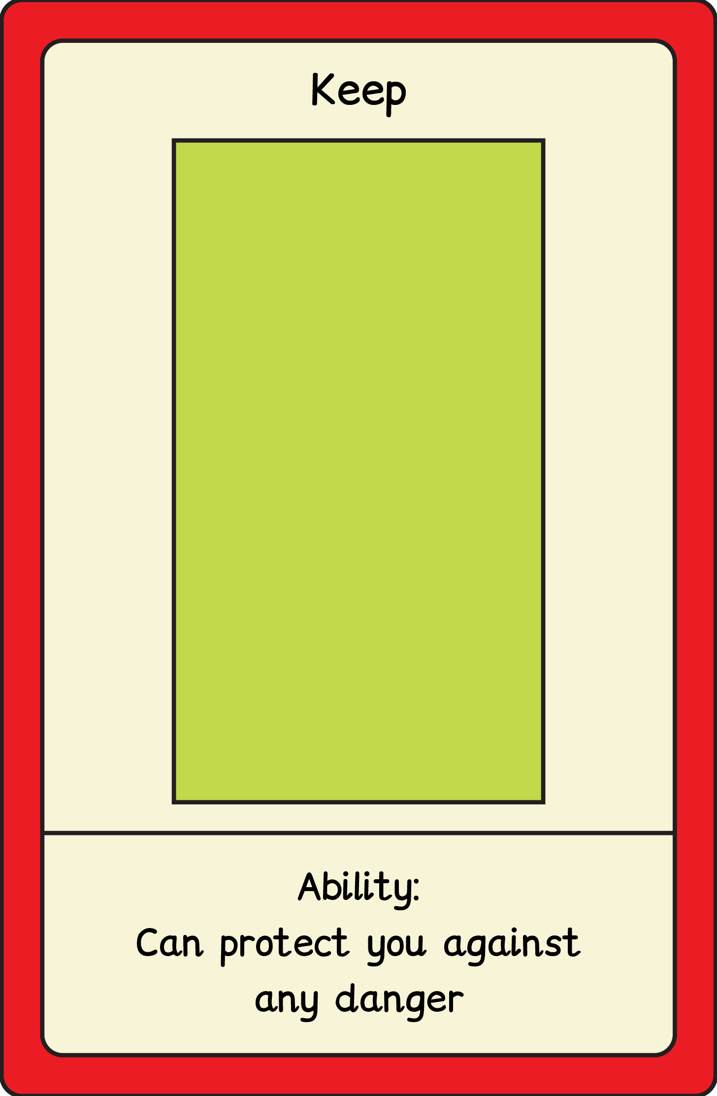

Slide 3

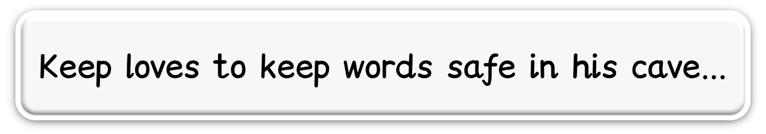
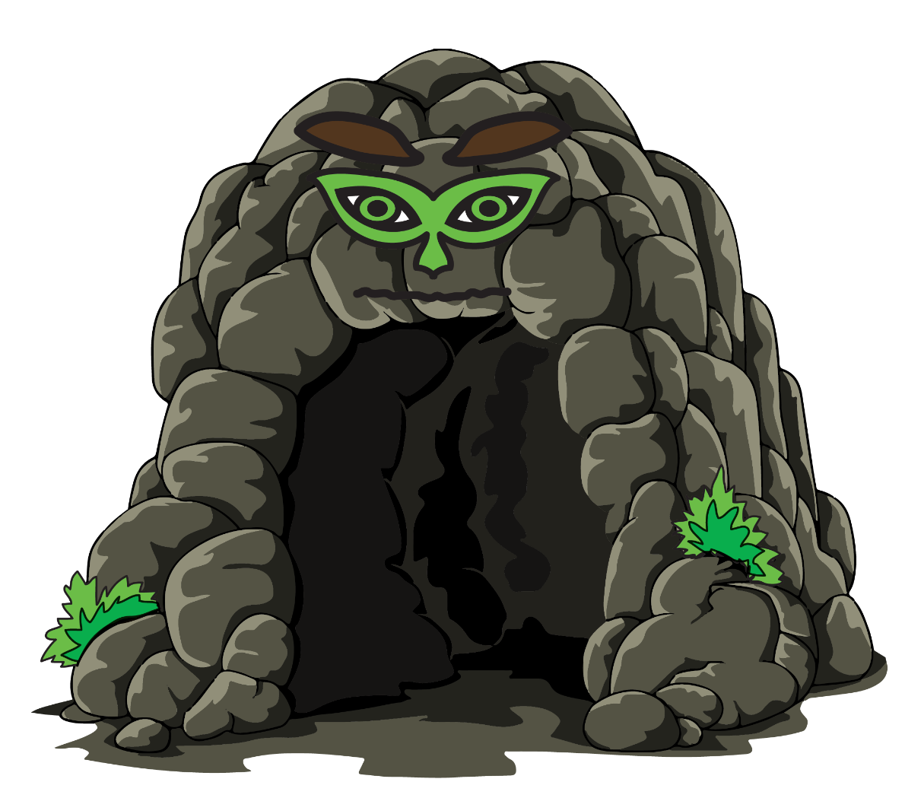
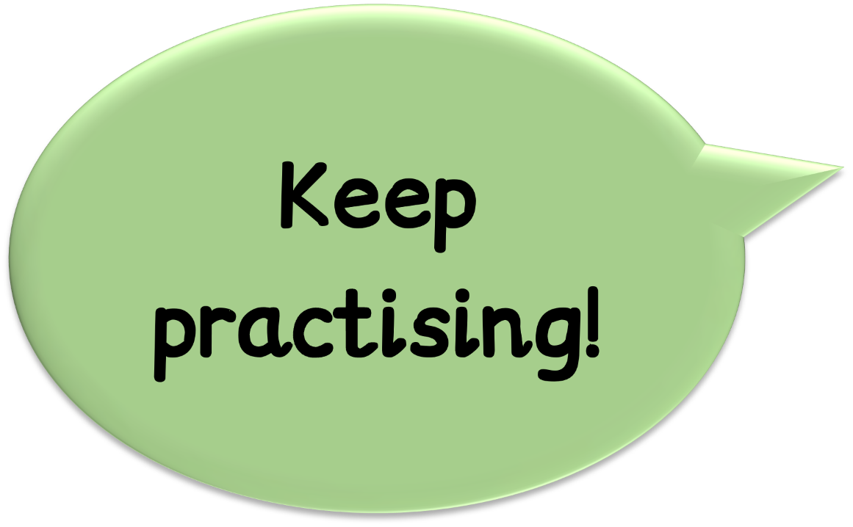

Slide 4

frequently
Happening a lot or very often

Slide 5
rarely
Almost never or not very often at all

Slide 6
sometimes
Happening every once in a while, not all the time

Slide 7
always
Happening all the time, without stopping

Slide 8
often
Happening many times, but not always

Slide 9
probably
Something is likely to happen but it’s not for sure

Slide 10
perhaps
Something could happen, but it’s not certain

Slide 11
definitely
Something is absolutely sure to happen

Slide 12
certainly
Something is sure to happen, and there's no doubt about it

Slide 13
maybe
Something might happen

