Slide 1
The River Nile
Ancient Egypt: what stayed the same across 3,000 years?

Slide 2
I can describe where and when the Ancient Egyptians lived and explain why the River Nile was important for them.

Slide 3
civilisation
BC
BCE
fertile

Slide 4
A civilisation is a well-organised group of people with their own language and way of life.
BC is short for 'Before Christ' and refers to the time before the year 1, in which people believe Jesus was born.
BCE is short for 'Before Common Era' and refers to the time before the year 1.
Soil or land that can produce farm crops or other plants is fertile.

Slide 5

The River Nile
When and where did the Ancient Egyptians live?
The importance of the River Nile in Ancient Egypt

Slide 6

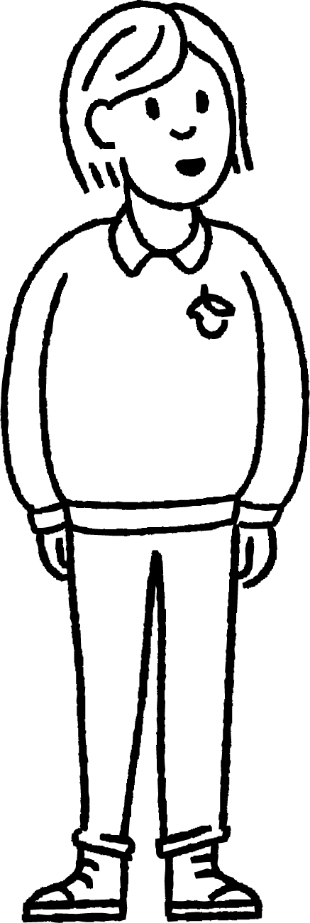
When and where did the Ancient Egyptians live?
The Ancient Egyptians were a civilisation that lived around 5,000 years ago.
At one time there were two kingdoms: Upper Egypt and Lower Egypt.
When those kingdoms united in around 3000 BC or BCE, that was the start of the Ancient Egyptian civilisation.
BC and BCE are used for the years before the year 1, when people believe Jesus was born.

Slide 7
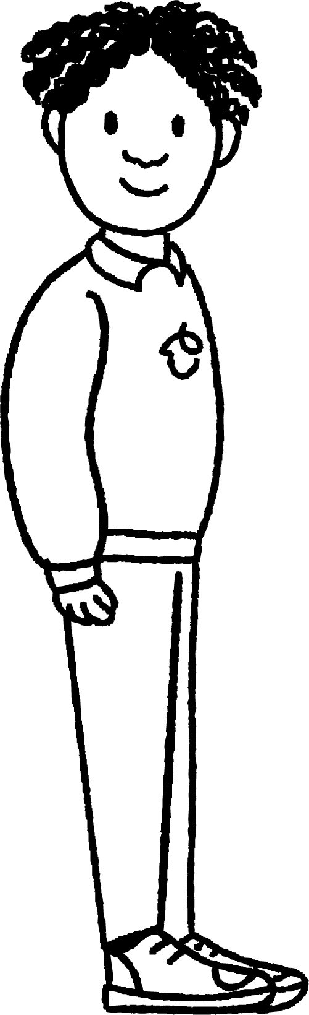
When and where did the Ancient Egyptians live?
The first ever king of Egypt was called Menes.
He became the first ruler when the two kingdoms of Upper and Lower Egypt became one.
He was the first of many great Ancient Egyptian rulers to come.
In Ancient Egypt, kings and queens were called pharaohs.

Slide 8
When and where did the Ancient Egyptians live?
Complete the missing labels to add information about the Ancient Egyptians to the timeline.
3000 BC or BCE
2024
?
People believe Jesus was born
I am learning about Egypt in school
?

Slide 9
When and where did the Ancient Egyptians live?
Complete the missing labels to add information about the Ancient Egyptians to the timeline.
3000 BC or BCE
2024
the year 1
People believe Jesus was born
I am learning about Egypt in school
Start of Ancient Egyptian civilisation

Slide 10
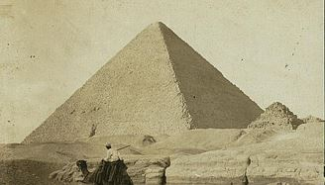
When and where did the Ancient Egyptians live?
Ancient Egypt was a large area of North Africa.
Today, the country of Egypt is still found in North Africa.
Many important landmarks from Ancient Egypt, like the pyramids, still exist and thousands of visitors see them every year.
A photo of a pyramid
Library of Congress Prints and Photographs Division [reproduction number LC-DIG-ppmsca-05038]

Slide 11
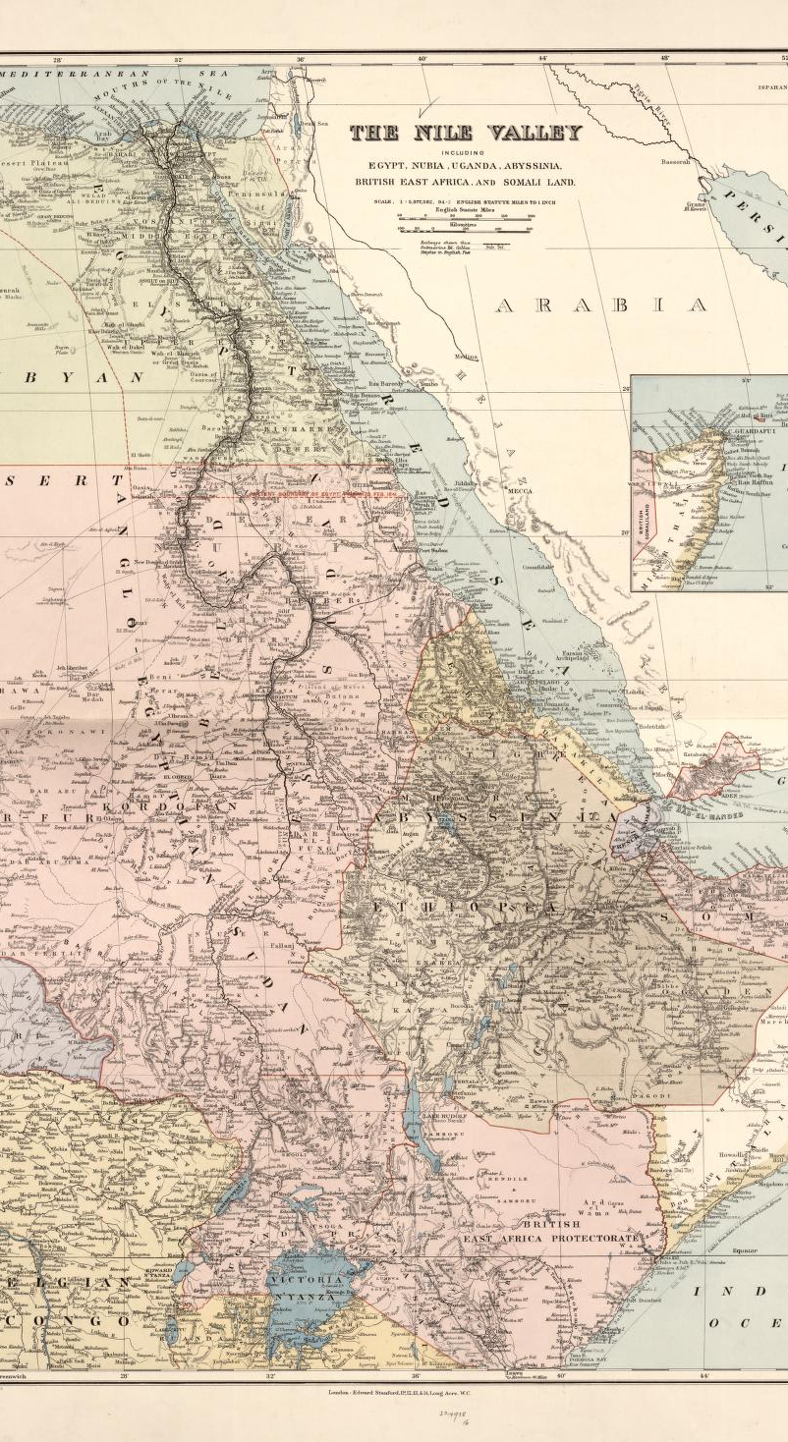
When and where did the Ancient Egyptians live?
The River Nile is found in North Africa. At more than 4,000 miles long, it is Africa’s longest river.
It starts at Lake Victoria and flows into the Mediterranean Sea when it reaches the northern coast of Egypt.
The Ancient Egyptian civilisation grew around this mighty river.
Map of the River Nile
Library of Congress, Geography and Map Division

Slide 12
The River Nile
When and where did the Ancient Egyptians live?
The importance of the River Nile in Ancient Egypt

Slide 13

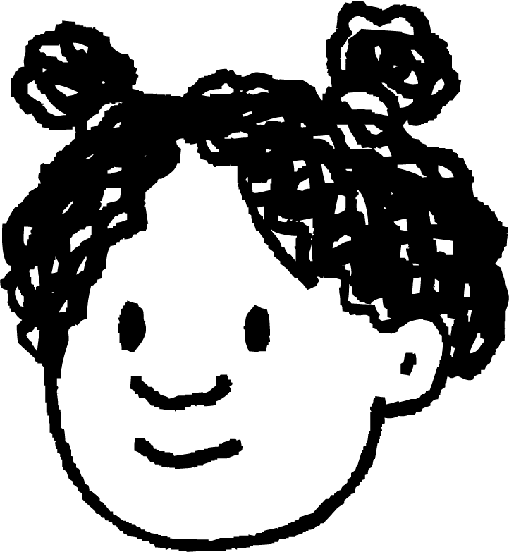
The importance of the River Nile in Ancient Egypt
The River Nile was important for the Ancient Egyptians because it provided fertile soil for farming.
When the river flooded, mud from the river bed was washed over the land and turned it black. The mud soaked into the soil and made it very fertile.
So, crops grew easily there because of all the nutrients in the soil, that came from the thick black mud of the River Nile.
The River Nile floods regularly at the same time every year!

Slide 14

The importance of the River Nile in Ancient Egypt
What happened each year which turned the land surrounding the River Nile black?
fires
floods
frost

Slide 15
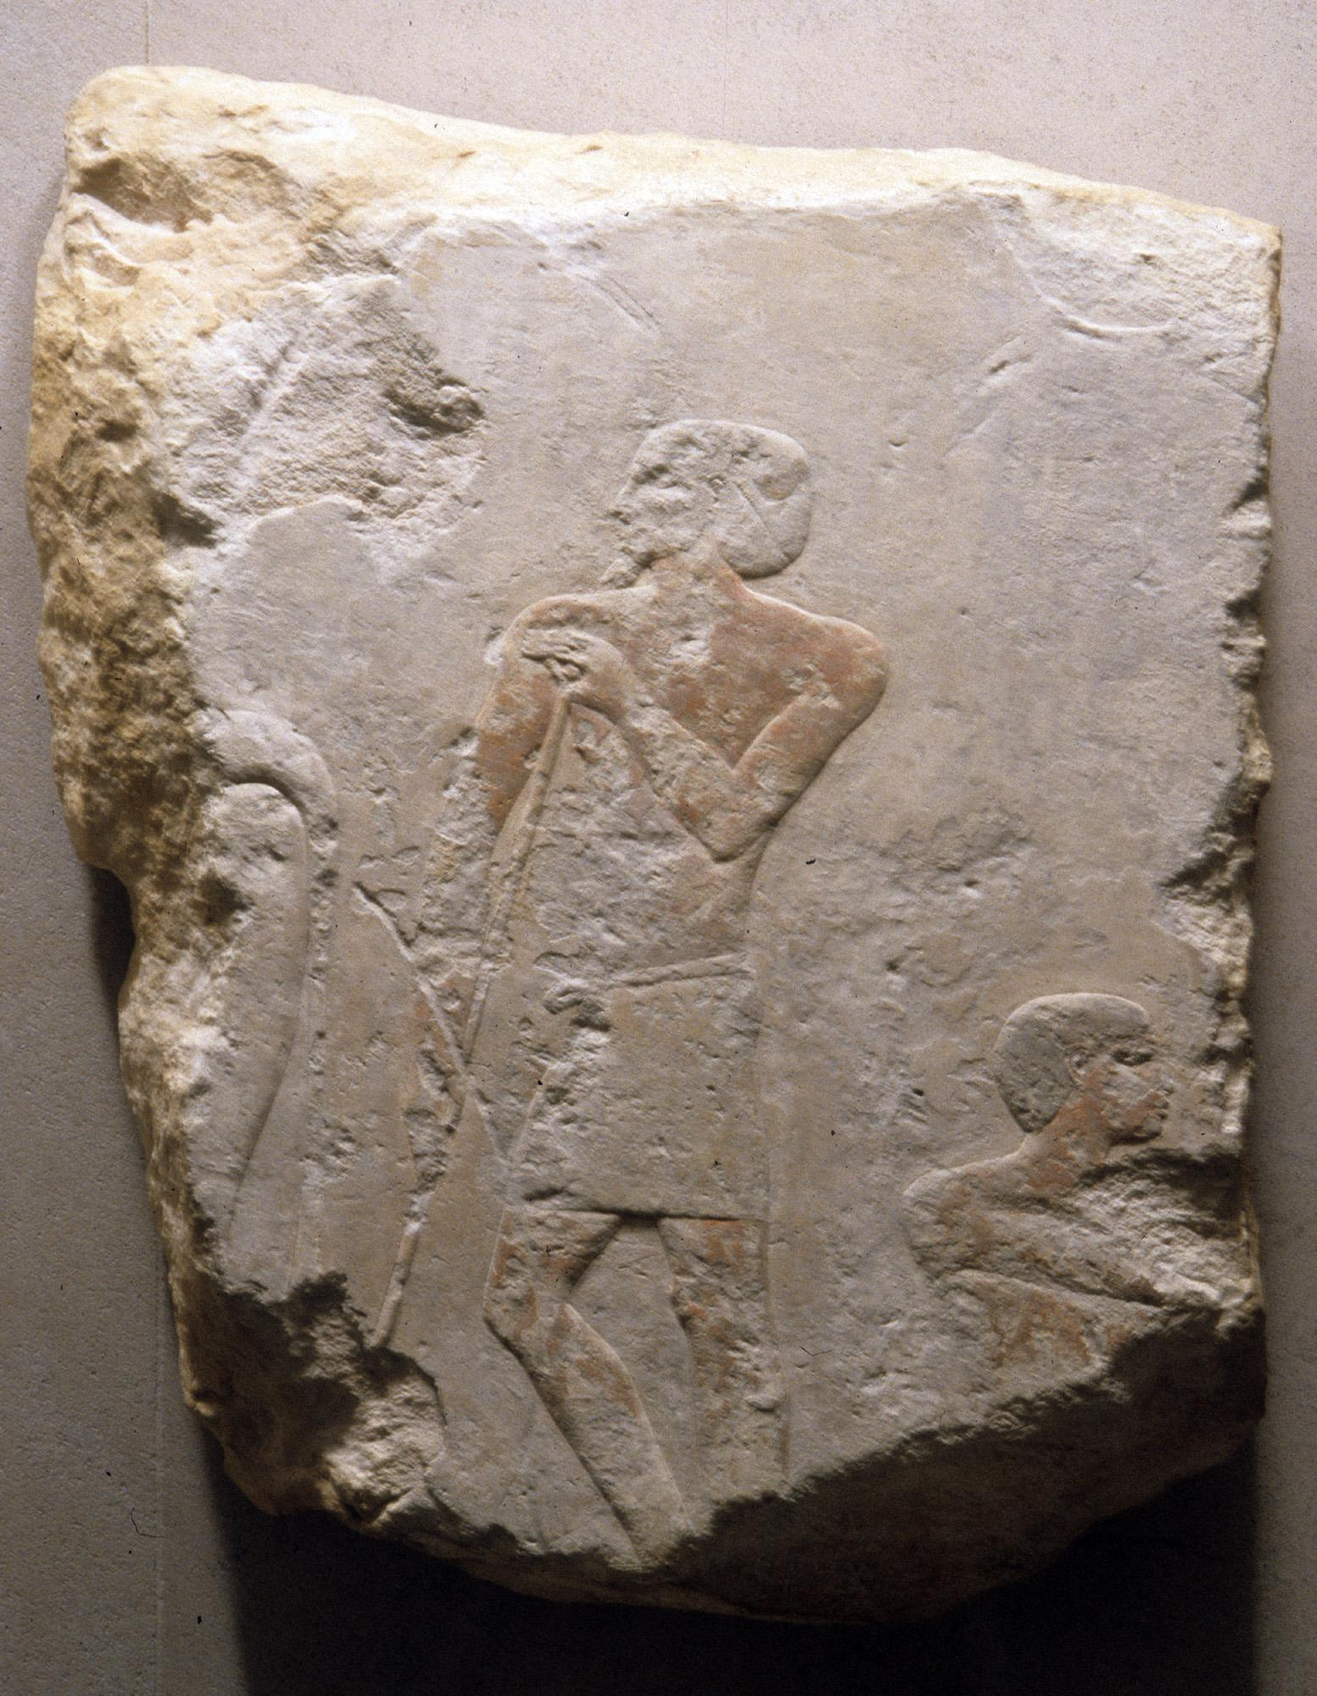
The importance of the River Nile in Ancient Egypt
Thanks to the fertile soil around the River Nile, the Ancient Egyptian civilisation made a lot of money from farming.
They grew crops like cereals and farmed animals such as cattle and goats. They used handmade tools and animals to help with ploughing and harvesting.
They transported produce along the River Nile in boats to the places where it was sold.
Sculpture of a scene of Ancient Egyptian cattle farming

Slide 16
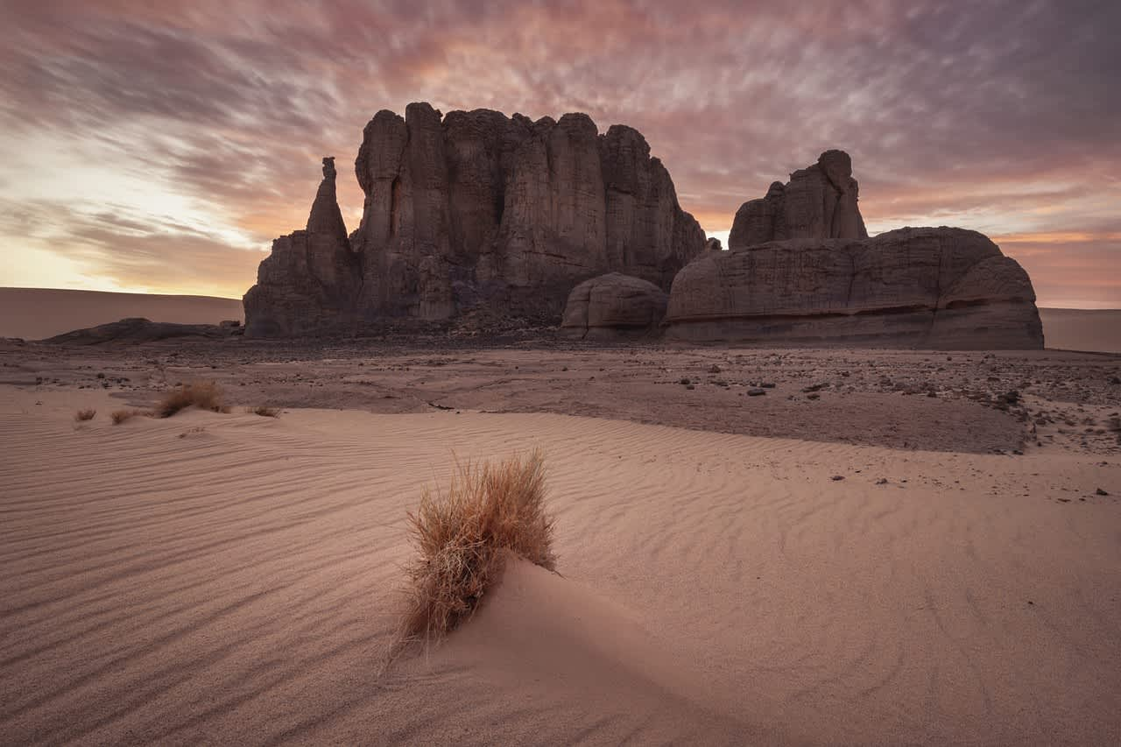
The importance of the River Nile in Ancient Egypt
The people of Ancient Egypt lived in villages around the River Nile because they could easily get crops and money from the fertile soil.
It was also a safe place for them to live because of the vast Sahara Desert surrounding them, which helped keep enemies away.
Photo of the Sahara Desert
The people of Ancient Egypt had the perfect location to live, survive and expand their civilisation.

Slide 17
The importance of the River Nile in Ancient Egypt
The land around the River Nile was a great location for Ancient Egyptian villages to develop.
The River Nile was very pretty and there was lots of wildlife in the Sahara Desert.
The River Nile provided fertile soil and the Sahara Desert provided protection from enemies.

Slide 18
The importance of the River Nile in Ancient Egypt
Answer the following questions. You could discuss your answers with your partner or your teacher first.
Why was the River Nile so important to the Ancient Egyptians?
Why did the River Nile flooding help the Ancient Egyptians?
Why were the banks of the River Nile a safe place for the Ancient Egyptians to live?

Slide 19
The importance of the River Nile in Ancient Egypt
Your answers to the questions could include:
Why was the River Nile so important to the Ancient Egyptians?
The River Nile was important for the Ancient Egyptians because it provided fertile soil for farming.
Why did the River Nile flooding help the Ancient Egyptians?
When the river flooded, mud from the river bed was washed over the land and turned it black. The mud soaked into the soil and made it very fertile.
Why were the banks of the River Nile a safe place for the Ancient Egyptians to live?
The banks of the River Nile were a safe place for the Ancient Egyptians to live because of the vast Sahara Desert surrounding them, which helped keep enemies away.

Slide 20
The River Nile
The Ancient Egyptian civilisation began around
3000 BC or BCE when the two kingdoms of Egypt (Upper Egypt and Lower Egypt) were united.
Ancient Egyptian settlements grew around the River Nile, the longest river in Africa.
Ancient Egyptians successfully farmed the fertile land around the River Nile. The fertile land was caused by the regular floods that covered the land with thick, black mud.
The fertile land around the River Nile and protection provided by the Sahara Desert helped the civilisation grow.

