Slide 1


Slide 3
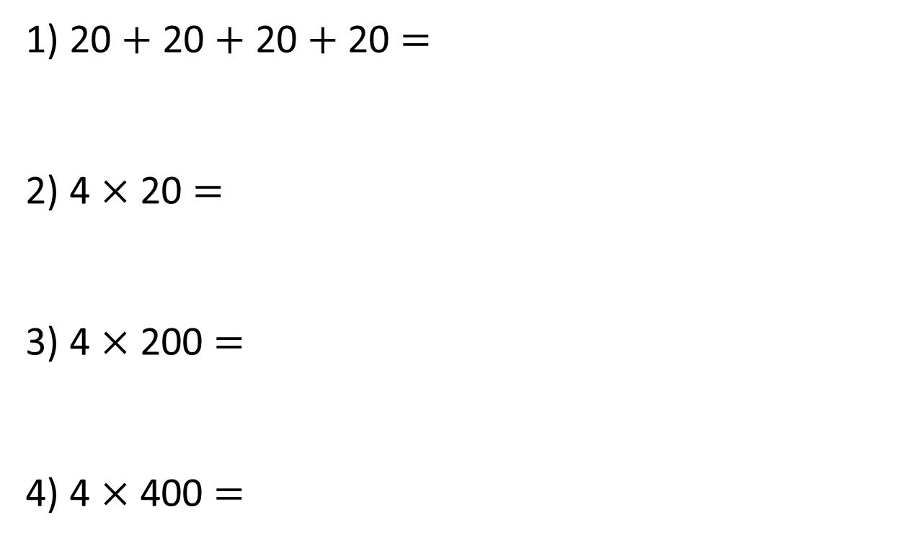
1) 20 $+$ 20 $+$ 20 $+$ 20 $=$
2) 4 $×$ 20 $=$
3) 4 $×$ 200 $=$
4) 4 $×$ 400 $=$

Slide 4
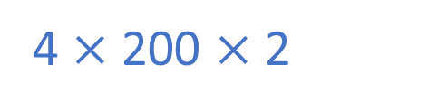
1) 20 $+$ 20 $+$ 20 $+$ 20 $=$
2) 4 $×$ 20 $=$
3) 4 $×$ 200 $=$
4) 4 $×$ 400 $=$
80
80
800
1,600
4 $×$ 200 $×$ 2

Slide 6





Complete the sentences to describe the multiplication.
Thousands | Hundreds | Tens | Ones
There are ____ ones altogether.
4
How does multiplication link to addition?
There are ____ tens altogether.
6
There are ____ hundreds altogether.
4
There are ____ thousands altogether.
8
Have a think
4,232 $×$ 2 $=$ _______
8,464

Slide 7
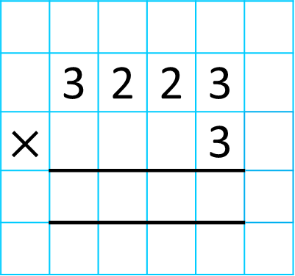
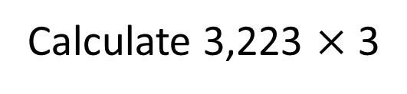
Calculate 3,223 $×$ 3
Thousands | Hundreds | Tens | Ones
 | 3 | 2 | 2 | 3
$×$ |  |  |  | 3
9
6
6
9
Which column do you start with?
Do you need to make an exchange?
9,669
Have a think

Slide 8

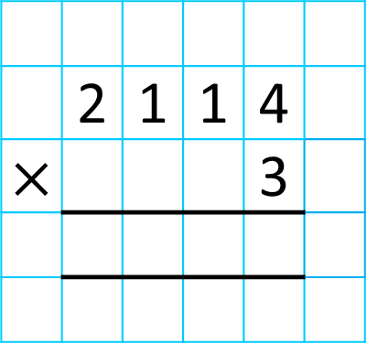
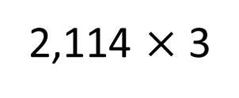
There are 2,114 seats in a theatre. The theatre is fully
booked for 3 shows. How many people attend overall?
2,114 $×$ 3
Thousands | Hundreds | Tens | Ones
 | 2 | 1 | 1 | 4
$×$ |  |  |  | 3
6
3
4
2
1
Do you need to make an exchange?
Have a think
6,342 people attend.

Slide 9

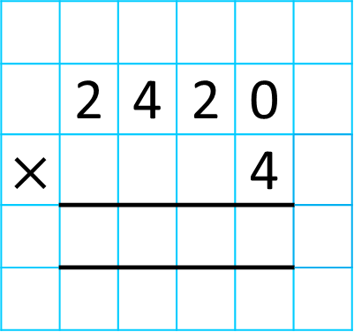
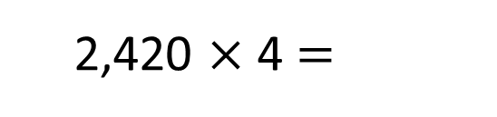
2,420 $×$ 4 $=$
Thousands | Hundreds | Tens | Ones
 | 2 | 4 | 2 | 0
$×$ |  |  |  | 4
9
6
8
1
Have a think
Do you agree with Tiny?

Slide 10
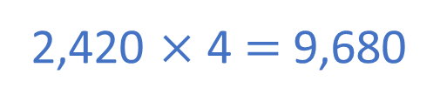
Thousands | Hundreds | Tens | Ones
 | 2 | 4 | 2 | 0
$×$ |  |  |  | 4
9
6
8
0
1
2,420 $×$ 4 $=$ 9,680

Slide 11
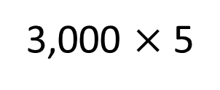
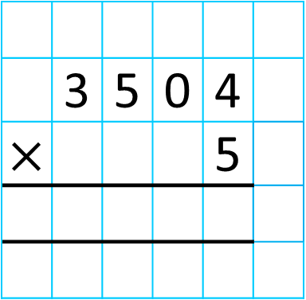
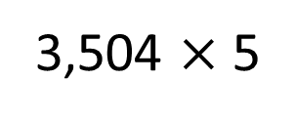
TTh | Th | H | T | O
3,504 $×$ 5
3,000 $×$ 5
 | 3 | 5 | 0 | 4
$×$ |  |  |  | 5
Have a think

Slide 12

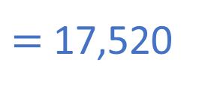
TTh | Th | H | T | O
3,504 $×$ 5
$=$ 17,520
 | 3 | 5 | 0 | 4
$×$ |  |  |  | 5
1
7
5
2
0
1
2
2

Slide 13
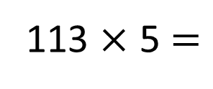
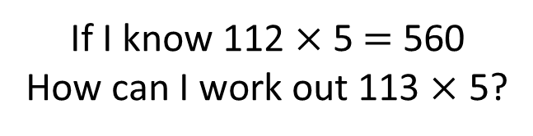
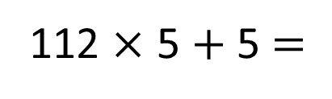
If I know 112 $×$ 5 $=$ 560
How can I work out 113 $×$ 5?
113
112
5
560
5
113 $×$ 5 $=$
112 $×$ 5 $+$ 5 $=$
565

Slide 14
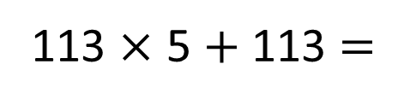
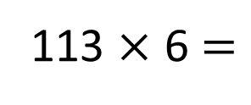
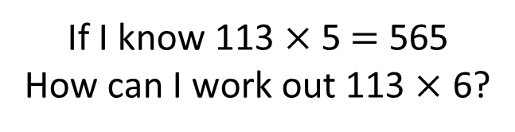
If I know 112 $×$ 5 $=$ 560
How can I work out 113 $×$ 5?
If I know 113 $×$ 5 $=$ 565
How can I work out 113 $×$ 6?
Have a think
113
112
5
565
560
5
6
113
113 $×$ 5 $=$
112 $×$ 5 $+$ 5 $=$
565
113 $×$ 6 $=$
113 $×$ 5 $+$ 113 $=$
678

Slide 15
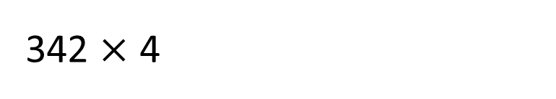
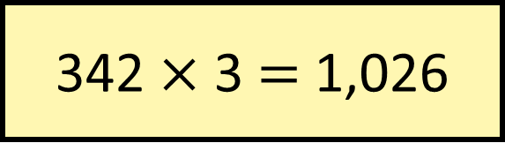

342 $×$ 3 $=$ 1,026
Without calculating, which is greater,
or
342 $×$ 4
343 $×$ 3?
343
342
342
Have a think
3
1,026
3
4

Slide 16



Slide 17
Have a go at questions

