Slide 1


Slide 3
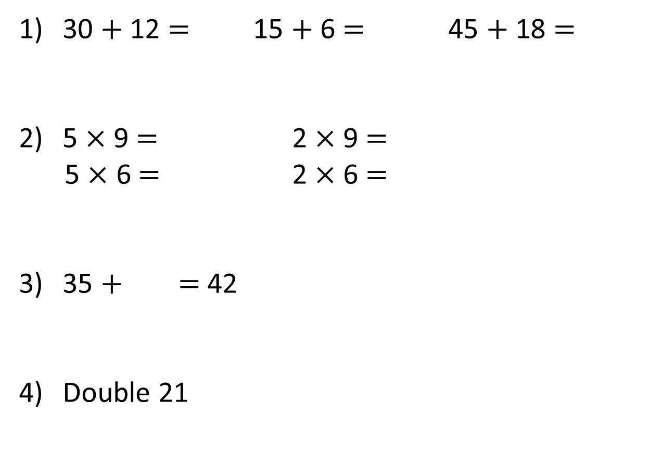
30 $+$ 12 $=$ 15 $+$ 6 $=$ 45 $+$ 18 $=$
5 $×$ 9 $=$ 2 $×$ 9 $=$
5 $×$ 6 $=$ 2 $×$ 6 $=$
35 $+$ $=$ 42
Double 21

Slide 4
30 $+$ 12 $=$ 15 $+$ 6 $=$ 45 $+$ 18 $=$
5 $×$ 9 $=$ 2 $×$ 9 $=$
5 $×$ 6 $=$ 2 $×$ 6 $=$
35 $+$ $=$ 42
Double 21
42
21
63
45
18
30
12
7
42

Slide 6
Complete the sentences.
5
There are ____ heptagons.
Each heptagon has ____ sides.
There are ____ sides altogether.
7
35

Slide 7


Complete the missing numbers.
5
There are ____heptagons.
Each heptagon has ____ sides.
There are ____ sides altogether.
7
35
7
7
35
$+ + + + =$
7
7
7
$× =$
5
7
35
$× =$
7
5
35

Slide 8


Complete the sentences.
7
There are ____ vases.
There are ____ flowers in each vase.
There are ____ flowers altogether.
4
28
Have a think

Slide 9


Complete the missing numbers.
7
There are ____ vases.
There are ____ flowers in each vase.
There are ____ flowers altogether.
4
28
$+ + + + + + =$
4
4
4
4
4
4
4
28
$× =$
7
4
28
$× =$
Have a think
4
7
28

Slide 10



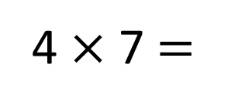
Who is older?
I’m 21 days older than Ron!
I’m 4 weeks older than Ron.
28 days
?
7
7
7
7
1 week
1 week
1 week
1 week
28
One week $=$ 7 days
4 $×$ 7 $=$
Whitney is older than Jack.

Slide 11



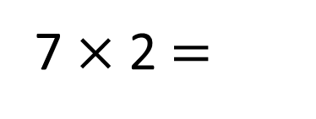
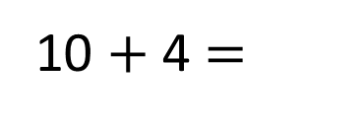
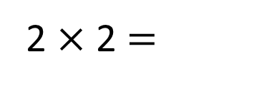
I’m not confident with my 7 times-table yet.
4
10
14
So I can add 5 lots and 2 lots together.
Why don’t you use your 2 and 5 times-tables to help you. Watch…
7 $×$ 2 $=$
14
5 $×$ 2 $=$
10
2 $×$ 2 $=$
4
10 $+$ 4 $=$
14

Slide 12
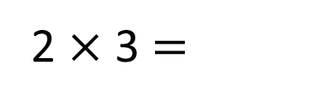

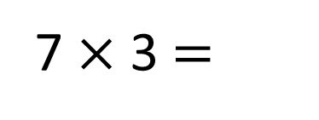
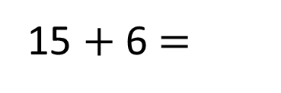
So I can add 5 lots and 2 lots together.
Why don’t you use your 2 and 5 times-tables to help you. Watch…
7 $×$ 3 $=$
7 $×$ 2 $=$
14
21
5 $×$ 2 $=$
5 $×$ 3 $=$
10
15
2 $×$ 2 $=$
2 $×$ 3 $=$
4
6
10 $+$ 4 $=$
15 $+$ 6 $=$
14
21

Slide 13
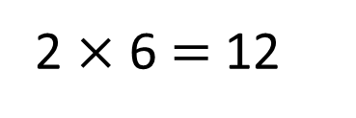
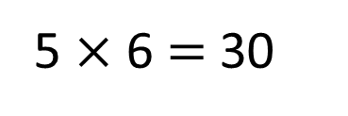
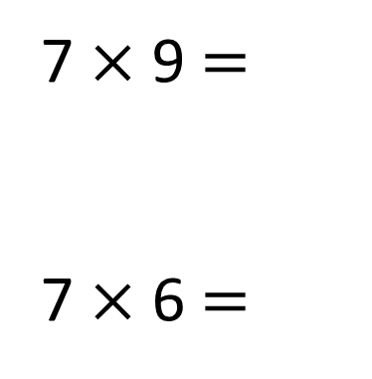
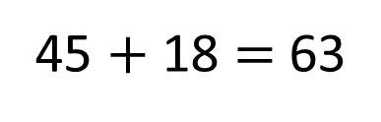
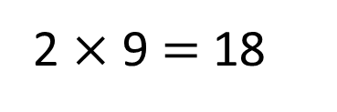

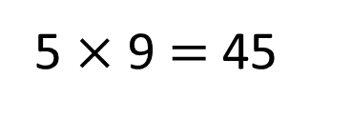
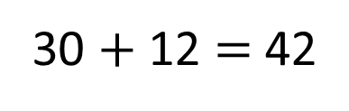
You could also subtract 7 from 70 like when we looked at the 9 times-table
You could also have done
5 $×$ 7 plus 1 $×$ 7
So I can add 5 lots and 2 lots together.
Have a think
7 $×$ 9 $=$
7 $×$ 6 $=$
63
5 $×$ 9 $=$ 45
45 $+$ 18 $=$ 63
2 $×$ 9 $=$ 18
42
5 $×$ 6 $=$ 30
30 $+$ 12 $=$ 42
2 $×$ 6 $=$ 12

Slide 14


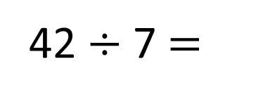
42 $÷$ 7 $=$
6
Have a think
I know that 35 $÷$ 7 is 5
7
5
35
6
42

Slide 15


42 $÷$ 7 $=$
6
I know that 35 $÷$ 7 is 5
I know that 21 $÷$ 3 is 7
7
3
21
6
42
3
21

Slide 16



Slide 17
Have a go at questions

Slide 18
I do
You do

Slide 19
















Rosie
Alex
Amir
Whitney
Ron
Dexter
Annie
Tommy
Mo
Jack
Eva
Teddy
Max
Kim
Jo
Sam

Slide 20



Speech bubble text – replace with any character head.
Speech bubble text – replace with any character head.
Bee
Diddy
Tiny

Slide 21


















100
40 | 60
TTh | Th | H | T | O | Tth | Hth

Slide 22










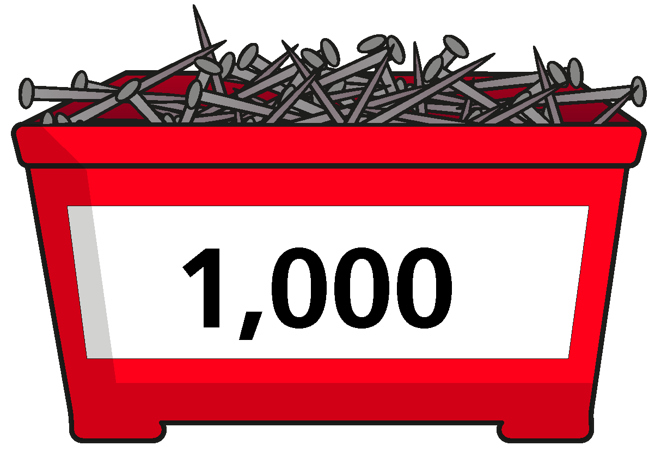


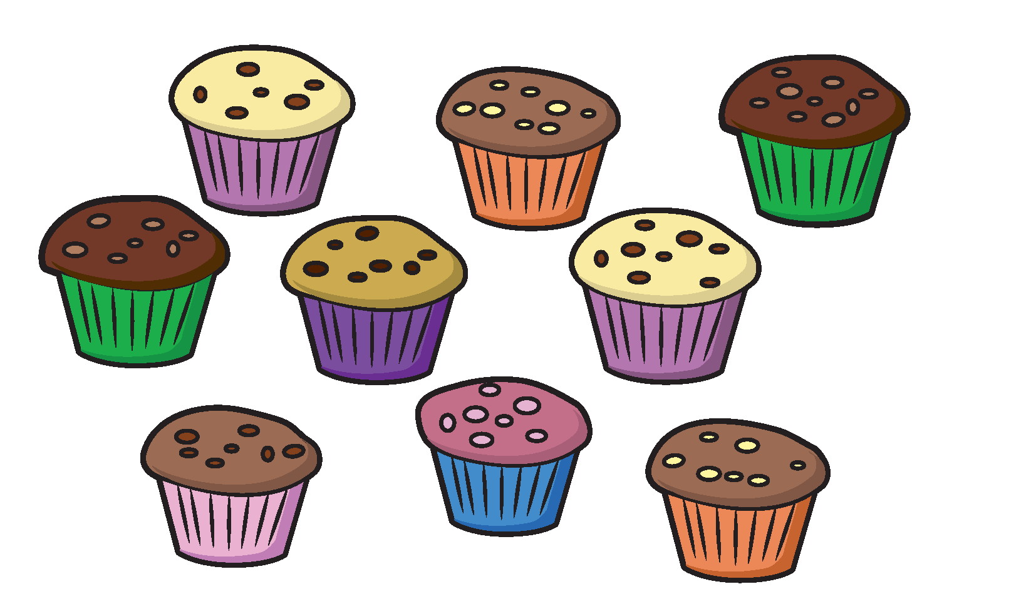



























Slide 23


























































