Slide 1


Slide 3


1) How many apples?
2) Write a number sentence to represent the fish.
3) Complete the number track.
4 | 8 | 12 |  |  | 24 |  | 32 |  | 40 |  | 48

Slide 4
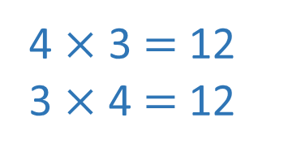
1) How many apples?
2) Write a number sentence to represent the fish.
3) Complete the number track.
24
4 $×$ 3 $=$ 12
3 $×$ 4 $=$ 12
4 | 8 | 12 |  |  | 24 |  | 32 |  | 40 |  | 48
16
20
28
36
44

Slide 6

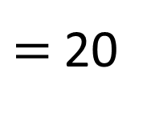
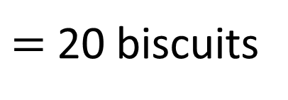
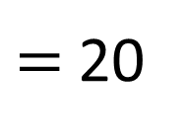
5 lots of 4 biscuits
$=$ 20 biscuits
There are 5 groups of 4 in 20
5 × 4
$=$20
4 × 5
$=$20

Slide 7

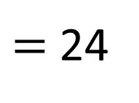
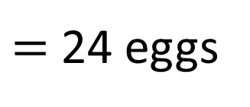
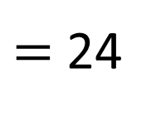
4 lots of 6 eggs
$=$ 24 eggs
There are 4 groups of 6 in 24
4 × 6
$=$ 24
6 × 4
$=$ 24

Slide 8
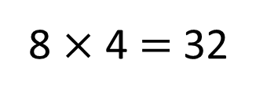
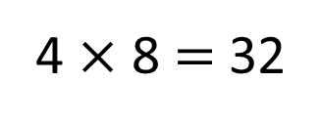
32 divided into 4 equal groups
4 rows of 8
4 × 8 $=$ 32
32 ÷ 4 = 8
8 columns of 4
32 divided into 8 equal groups
32 ÷ 8 = 4
8 × 4 $=$ 32

Slide 9
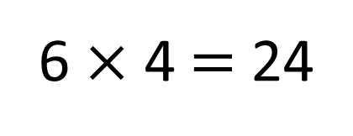
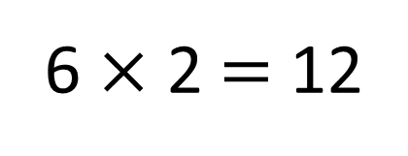
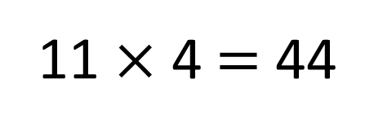
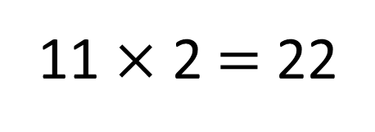
2 | 4 | 6 | 8 | 10 | 12 | 14 | 16 | 18 | 20 | 22 | 24
4 | 8 | 12 | 16 | 20 | 24 | 28 | 32 | 36 | 40 | 44 | 48
6 × 2 $=$ 12
11 × 2 $=$ 22
6 × 4 $=$ 24
11 × 4 $=$ 44

Slide 10

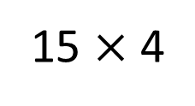
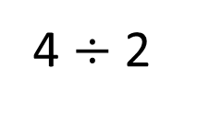
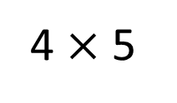
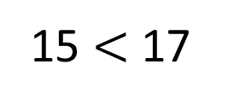
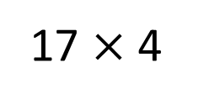
Have a think
Write $<$, $>$ or $=$ to compare the statements.
4 $÷$ 2
$$>$$
20
4 $×$ 5
2
$$<$$
15 $×$ 4
17 $×$ 4
15 $<$ 17

Slide 11


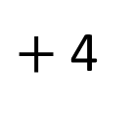
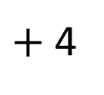
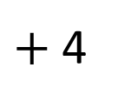
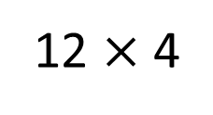
What is 15 $×$ 4?
Have a think
I started from 12 $×$ 4 and counted up 3 more 4s
12 $×$ 4
$+$ 4
$+$ 4
$+$ 4
0
48
52
56
60

Slide 12

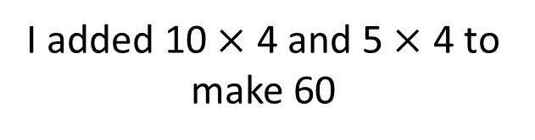
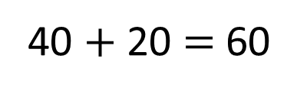
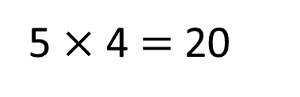
What is 15 $×$ 4?
I added 10 $×$ 4 and 5 $×$ 4 to make 60
5 $×$ 4 $=$ 20
10 $×$ 4 $=$ 40
40 $+$ 20 $=$ 60

Slide 13

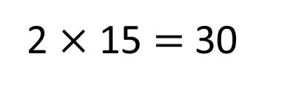
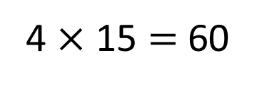
What is 15 $×$ 4?
I doubled 15 and then doubled it again.
double
double
15
15
15
15
15
15
15
2 $×$ 15 $=$ 30
4 $×$ 15 $=$ 60

Slide 14



Slide 15
Have a go at questions

Slide 16
I do
You do

Slide 17
















Rosie
Alex
Amir
Whitney
Ron
Dexter
Annie
Tommy
Mo
Jack
Eva
Teddy
Max
Kim
Jo
Sam

Slide 18



Speech bubble text – replace with any character head.
Speech bubble text – replace with any character head.
Bee
Diddy
Tiny

Slide 19


















100
40 | 60
TTh | Th | H | T | O | Tth | Hth

Slide 20









































Slide 21


























































